Slide 1
Chapter 29
Interest Rate Derivatives: The Standard Market Models

Slide 2
The Complications in Valuing Interest Rate Derivatives
We need a whole term structure to define the level of interest rates at any time
The stochastic process for an interest rate is more complicated than that for a stock price
Volatilities of different points on the term structure are different
Interest rates are used for discounting the payoff as well as for defining the payoff.

Slide 3
Approaches to Pricing
Interest Rate Options
Use a variant of Black’s model
Use a no-arbitrage (yield curve based) model

Slide 4
Black’s Model
Similar to the model proposed by Fischer Black for valuing options on futures in 1976
Assumes that the value of an interest rate, a bond price, or some other variable at a particular time T in the future has a lognormal distribution

Slide 5
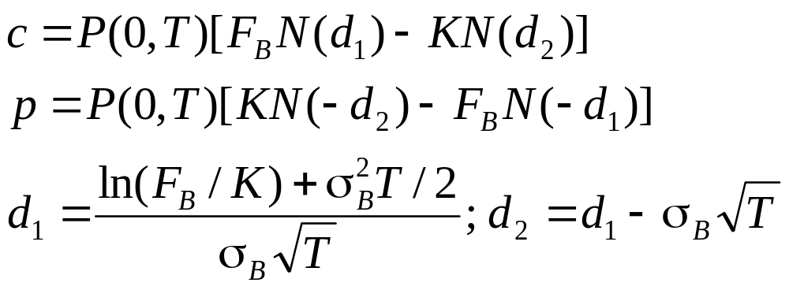
Black’s Model for European Bond Options (Equations 29.1 and 29.2)
Assume that the future bond price is lognormal
Both the bond price and the strike price should be cash prices not quoted prices

Slide 6
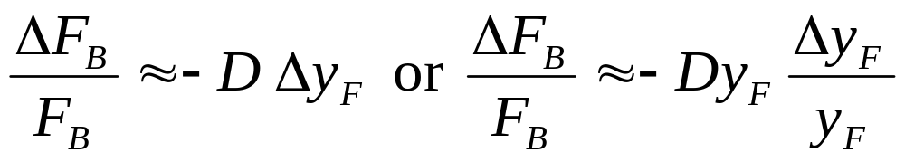
Forward Bond and Forward Yield
Approximate duration relation between forward bond price, F_{B}, and forward bond yield, y_{F}
where D is the (modified) duration of the forward bond at option maturity

Slide 7
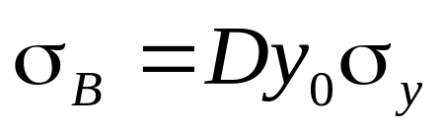
Yield Vols vs Price Vols (Equation 29.4)
This relationship implies the following approximation
where σ_{y} is the forward yield volatility, σ_{B} is the forward price volatility, and y₀ is today’s forward yield
Often σ_{y} is quoted with the understanding that this relationship will be used to calculate σ_{B}

Slide 8
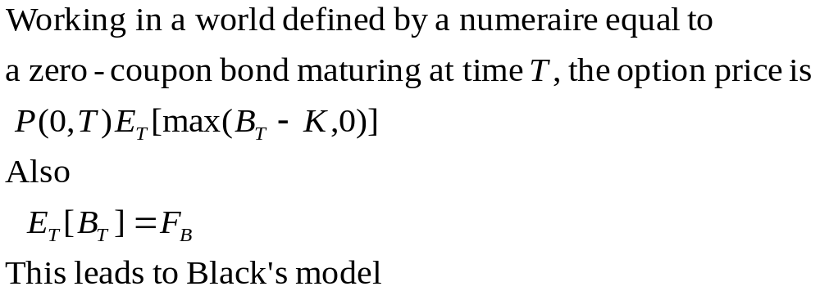
Theoretical Justification for Bond Option Model

Slide 9
Caps and Floors
A cap is a portfolio of call options on interest rates. It has the effect of guaranteeing that the interest rate in each of a number of future periods will not rise above a certain level
Payoff at time t_{k+1} is Lδ_{k} max(R_{k}−R_{K}, 0) where L is the principal, δ_{k} =t_{k+1} − t_{k} , R_{K} is the cap rate, and R_{k} is the rate at time t_{k} for the period between t_{k} and t_{k+1}
A floor is similarly a portfolio of put options on interest rates. Payoff at time t_{k+1} is
Lδ_{k} max(R_{K} − R_{k} , 0)

Slide 10
Caplets
A cap is a portfolio of “caplets”
Each caplet is a call option on a future interest rate with the payoff occurring in arrears
When using Black’s model we assume that the interest rate underlying each caplet is lognormal

Slide 11
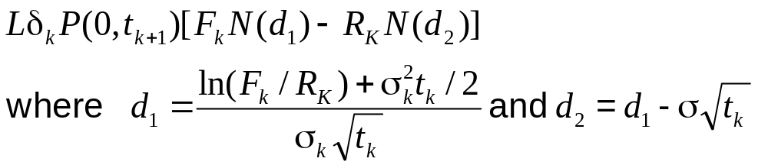

Black’s Model for Caps (equations 29.7 and 29.8)
The value of a caplet, for period (t_{k}, t_{k+1}) is
The value of a floorlet is
F_{k} : forward interest rate
for (t_{k}, t_{k+1})
σ_{k} : forward rate volatility
L: principal
R_{K} : cap rate
δ_{k}=t_{k+1}-t_{k}

Slide 12
When Applying Black’s Model
To Caps We Must ...
EITHER
  Use spot volatilities
  Volatility different for each caplet
OR
  Use flat volatilities
  Volatility same for each caplet within a particular cap but varies according to life of cap

Slide 13
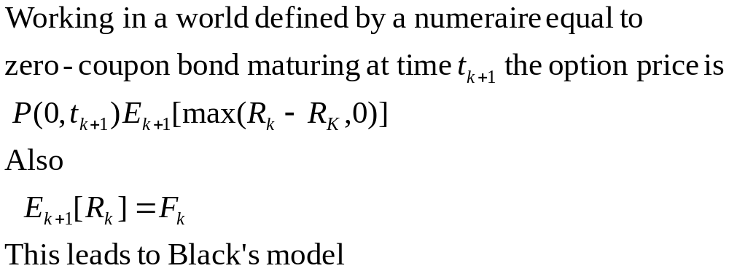
Theoretical Justification for Cap Model

Slide 14

Negative Rates
Can use a shifted lognormal model where F_{k} is replaced by F_{k} +α and R_{K} is replaced by R_{K}+α in Black’s model
Alternatively, the forward rate can be assumed to follow an arithmetic (normal) process:
This leads to the price of the caplet being
and the price of a floorlet being

Slide 15
Swaptions
A swaption or swap option gives the holder the right to enter into an interest rate swap in the future
Two kinds
  The right to pay a specified fixed rate and receive floating
  The right to receive a specified fixed rate and pay floating

Slide 16
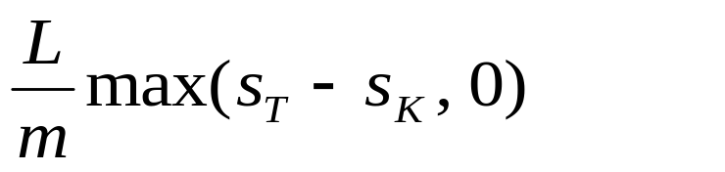
Black’s Model for European Swaptions
When valuing European swap options it is usual to assume that the swap rate is lognormal
Consider a swaption which gives the right to pay s_{K} on an n -year swap starting at time T. The payoff on each swap payment date is
where L is principal, m is payment frequency and s_{T} is market swap rate at time T

Slide 17
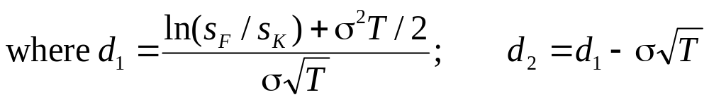
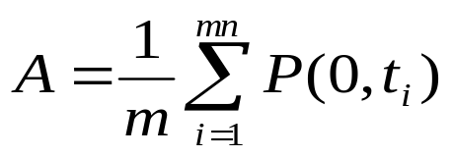
Black’s Model for European Swaptions continued (equations 29.10 and 29.11)
The value of the swaption where holder has right to pay s_{K} is LA[s_{F}N(d₁)−s_{K} N(d₂)]
The value of a swaption where the hold has the right to receive s_{K} is LA[s_{K}N(−d₂)−s_{F} N(−d₁)]
s_{F} is the forward swap rate; σ is the forward swap rate volatility; t_{i} is the time from today until the ith swap payment.

Slide 18
Black’s Model and OIS Discounting
A is defined by the OIS zero curve
s_{F} is defined by forward rates

Slide 19
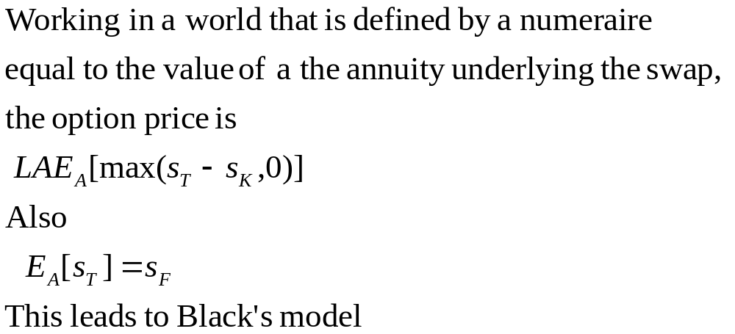
Theoretical Justification for Swap Option Model

Slide 20
Relationship Between Swaptions and Bond Options
An interest rate swap can be regarded as the exchange of a fixed-rate bond for a floating-rate bond
A swaption or swap option is therefore an option to exchange a fixed-rate bond for a floating-rate bond

Slide 21
Relationship Between Swaptions and Bond Options (continued)
At the start of the swap the floating-rate bond is worth par so that the swaption can be viewed as an option to exchange a fixed-rate bond for par
An option on a swap where fixed is paid and floating is received is a put option on the bond with a strike price of par
When floating is paid and fixed is received, it is a call option on the bond with a strike price of par

Slide 22
Negative Rates
Can use a shifted lognormal model where s_{F} is replaced by s_{F} +α and R_{K} is replaced by R_{K}+α in Black’s model
Alternatively the forward swap rate can be assumed to follow an arithmetic (normal) process
This leads to similar pricing formulas to those for caps

Slide 23
Deltas of Interest Rate Derivatives
Alternatives:
Calculate a DV01 (the impact of a 1bps parallel shift in the zero curve)
Calculate impact of small change in the quote for each instrument used to calculate the zero curve
Divide zero curve (or forward curve) into buckets and calculate the impact of a shift in each bucket
Carry out a principal components analysis for changes in the zero curve. Calculate delta with respect to each of the first two or three factors

